Slide 1
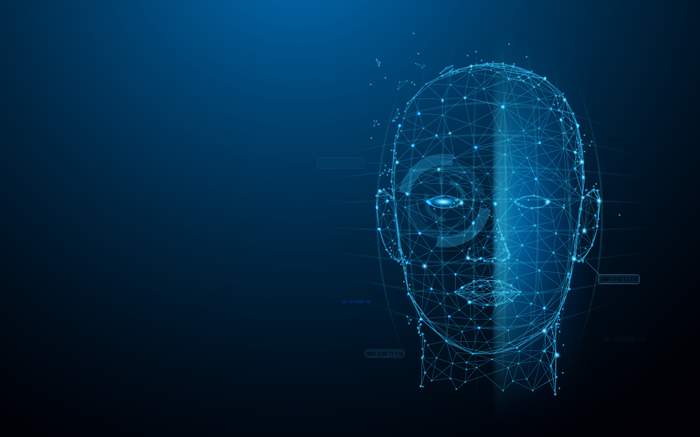
ds-630 project Human Face Recognition Attendance System
Group Member:
Khushaliben hareshbhai dixit
BijnaBen A Chandera
Thanuboadhi Naveen Reddy

Slide 2
Introduction
As we are making a system which can recognize face and match with its own database.
It will make the attendance system more authentic.
Our primary goal is to help different organizations to improve and organize the process of track and manage students or employees attendance and absenteeism.

Slide 3

What Is Face Detection?
FACE DETECTION IS A TYPE OF COMPUTER VISION TECHNOLOGY THAT IS ABLE TO IDENTIFY PEOPLE’S FACES WITHIN DIGITAL IMAGES.
THIS IS VERY EASY FOR HUMANS, BUT COMPUTERS NEED PRECISE INSTRUCTIONS.
THE IMAGES MIGHT CONTAIN MANY OBJECTS THAT AREN’T HUMAN FACES, LIKE BUILDINGS, CARS, ANIMALS, AND SO ON.

Slide 4
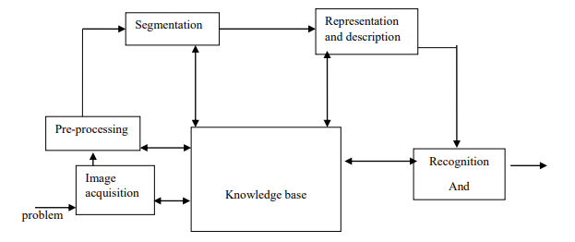
Plan of works

Slide 5
Software Used
PROGRAM LANGUAGE: PYTHON 3 WITH its LIBRARIES
SOFTWARE:
PYCHARM EDU CODE

Slide 6
Gui (graphical user interface)
GUI PROVIDES A BETTER EXPERIENCE IN WORKING WITH SOFTWARE.
SO,WE ARE PROVIDING OUR SOFTWARE WITH A GUI.
GUI WILL HELP EVEN NON TECHNICAL PERSON TO WORK WITH EASE IN OUR SOFTWARE.
A NICE GUI WILL HELP EVERY USER TO GET HIS/HER WORK DONE.

Slide 7
Advantages
THE SYSTEM STORES THE FACES THAT ARE DETECTED AND AUTOMATICALLY MARKS ATTENDANCE.
EASE OF USE IS TO RECOGNIZE THE FACES IN REAL TIME, USING MULTIPLE FACE DETECTION. MULTIPURPOSE SOFTWARE CAN BE USED IN DIFFERENT PLACES.

Slide 8
Limitations :
THE ACCURACY OF THE SYSTEM IS NOT 100%. IT CAN ONLY DETECT FACE FROM A LIMITED DISTANCE.

Slide 9
What Are Features?
A FEATURE IS A PIECE OF INFORMATION IN AN IMAGE THAT IS RELEVANT TO SOLVING A CERTAIN PROBLEM.
IT COULD BE SOMETHING AS SIMPLE AS A SINGLE PIXEL VALUE, OR MORE COMPLEX LIKE EDGES, CORNERS, AND SHAPES.
YOU CAN COMBINE MULTIPLE SIMPLE FEATURES INTO A COMPLEX FEATURE.
APPLYING CERTAIN OPERATIONS TO AN IMAGE PRODUCES INFORMATION THAT COULD BE CONSIDERED FEATURES AS WELL.
COMPUTER VISION AND IMAGE PROCESSING HAVE A LARGE COLLECTION OF USEFUL FEATURES AND FEATURE EXTRACTING OPERATIONS.
BASICALLY, ANY INHERENT OR DERIVED PROPERTY OF AN IMAGE COULD BE USED AS A FEATURE TO SOLVE TASKS.

Slide 10
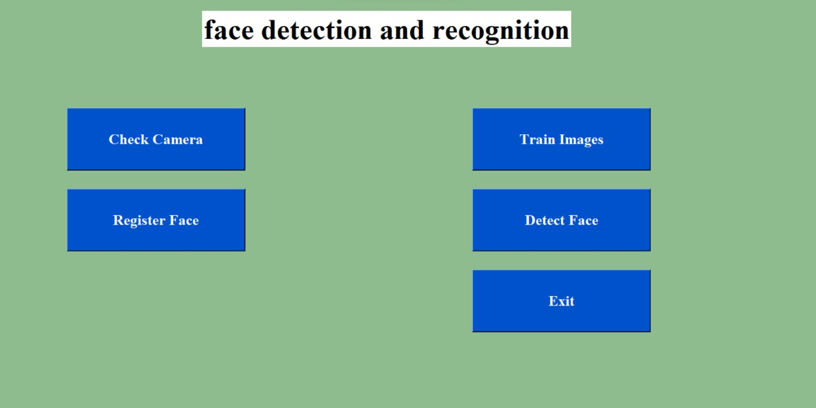
What we do

Slide 11
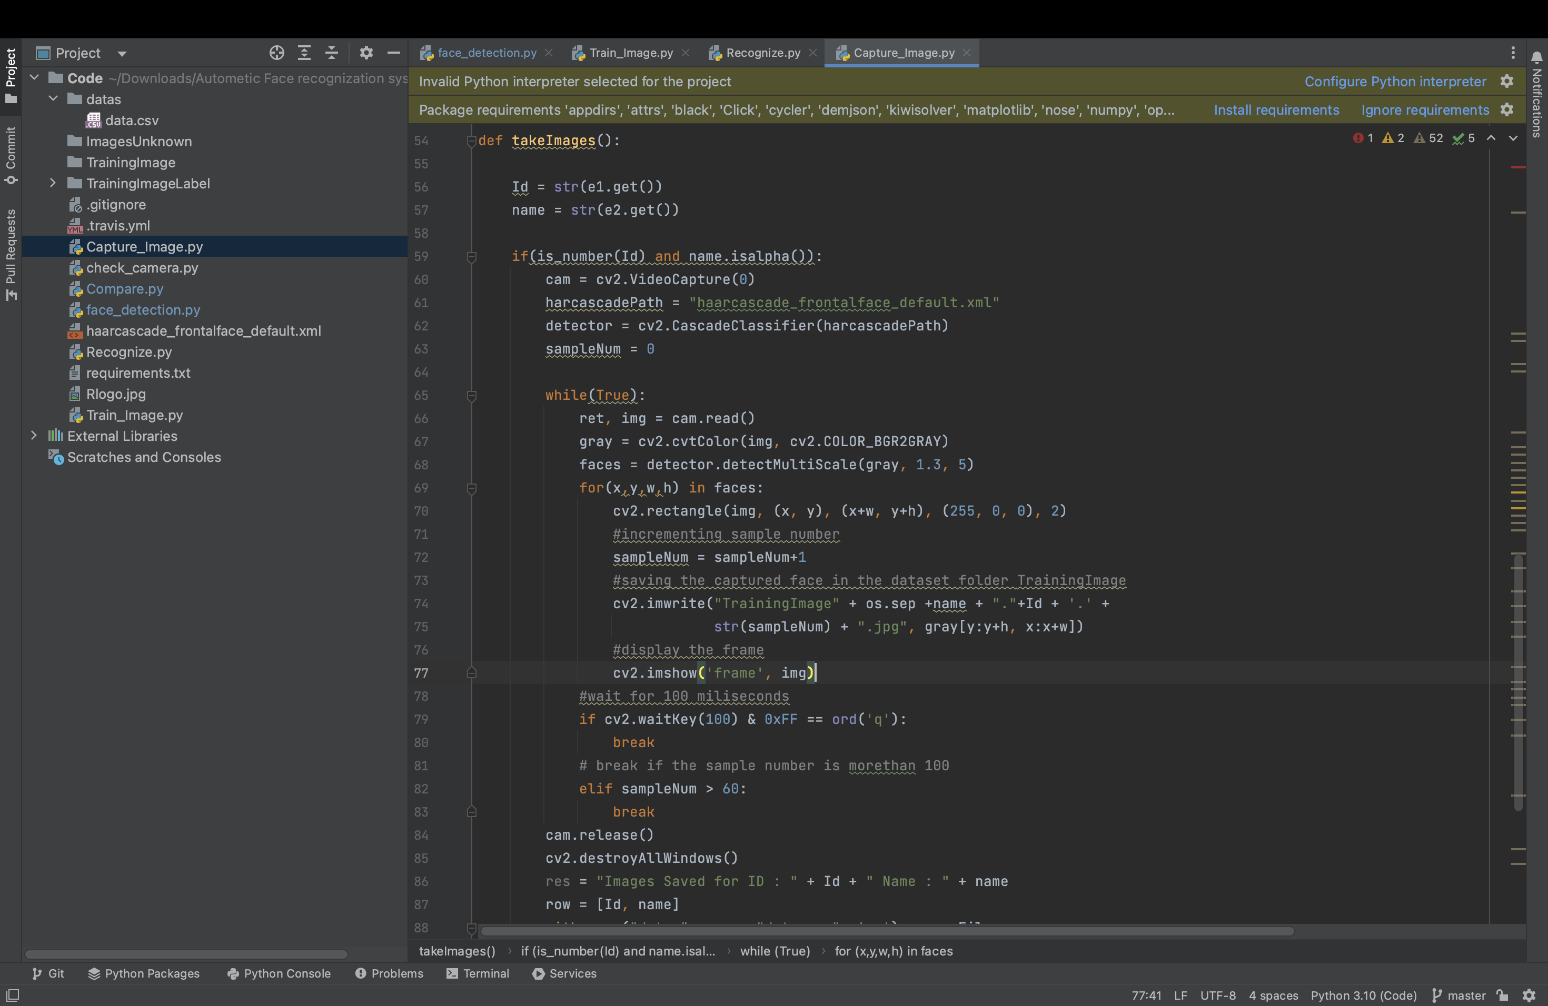
Capture image

Slide 12
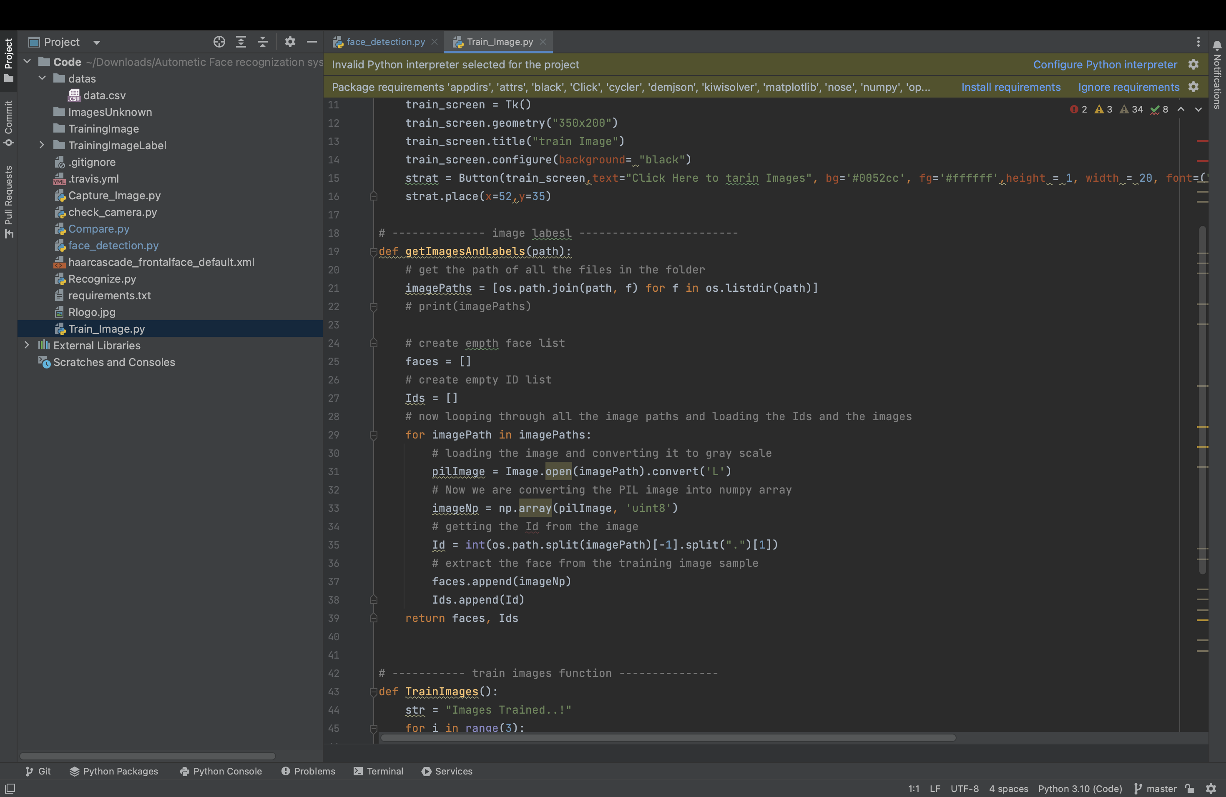
Train image

Slide 13
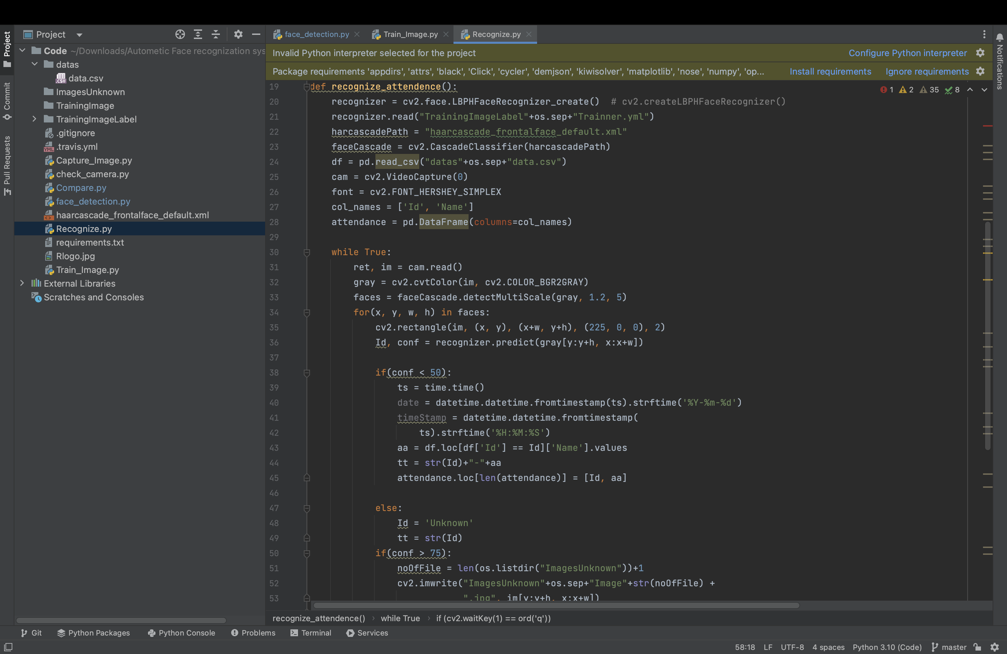
recognize

Slide 14
Result Analysis
IN OUR PROJECT WE HAVE BEEN WORKING MORE THE 120 PICTURES. OUR RESULT OF OUR PROJECT PERCENTAGES IS ALMOST 50-55%.
THOUGH IT IS NOT ENOUGH FOR THIS LITTLE DATASET.
TO MAKE ALMOST 98% ACCURACY WE NEED TO USE MORE POWERFUL HARDWARE AND ALSO NEED MORE RESOURCES.

Slide 15
Report generation
HERE WE CREATED A REPORT WHICH WILL HOLD THE ATTENDANCE OF THE STUDENTS FOR EVERYDAY RECORDS.
THIS REPORT WILL HAVE INFORMATION OF A STUDENT LIKE NAME & ID.
IN THIS REPORT WE CAN DIRECTLY GET THE LIST OF STUDENTS WHO ARE PRESENT AND ABSENT.

Slide 16
THANK YOU

